Slide 1
Cyber Security
Zafar Sadik
Zafar.sadik@computechlimited.com
www.computechlimited.com
KENYA | UGANDA | TANZANIA | RWANDA | |ZAMBIA | BURUNDI

Slide 2
Security Incidents
Kenyan Facebook users have lost millions of shillings to hackers(Identity Theft)
An Airline company had to convince the committee inquiring into its affairs over whether it’s IT system is secure (lack of access revocation)
2014. “Kenya Arrests 77 Chinese Nationals in Cybercrime Raids.”Ransomware, Phishing, DDOS , SQL Injection, Advanced Persistent Threats
In 2014, for instance, Kenya Banking Fraud Investigations Department reported hacking into customer bank accounts between 2012 and 2013 that led to losses of Sh1.49 billion. The schemes were hatched by staff
The annual cost of cybercrime to Kenyan companies in 2015 is estimated to be KES 15 billion (USD146 Million).
2017 wannacry outbreak (Ransomware)

Slide 5
INFORMATION SECURITY
Protects information from a range of threats
Ensures business continuity
Minimizes financial loss
Optimizes return on investments
Increases business opportunities
Business survival depends on information security.

Slide 6
Threat Sources
Source | Motivation | Threat
External Hackers | Challenge Ego Game Playing | System hacking Social engineering Dumpster diving
Internal Hackers | Deadline Financial problems Disenchantment | Backdoors Fraud Poor documentation
Terrorist | Revenge Political | System attacks Social engineering Letter bombs Viruses Denial of service
Poorly trained employees | Unintentional errors Programming errors Data entry errors | Corruption of data Malicious code introduction System bugs Unauthorized access

Slide 7
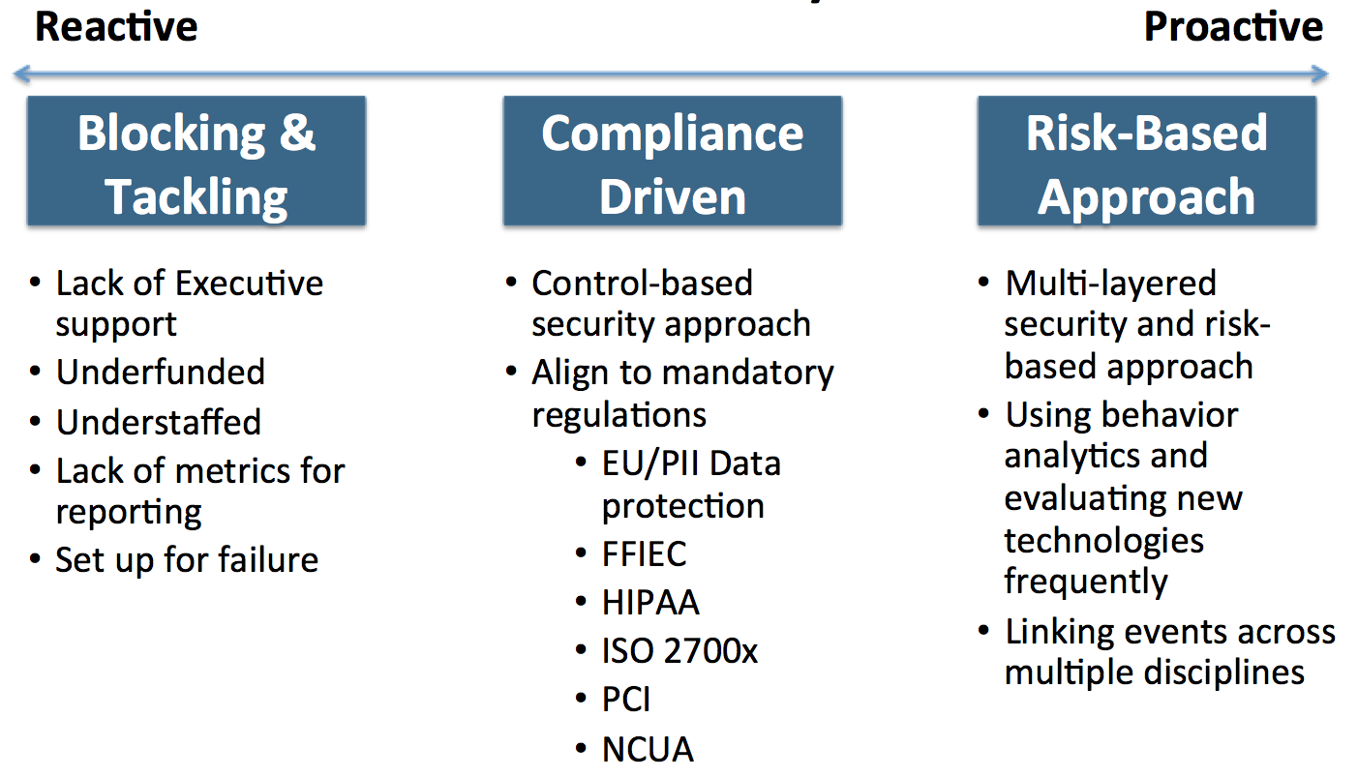
Security Maturity Assessment Chart

Slide 8
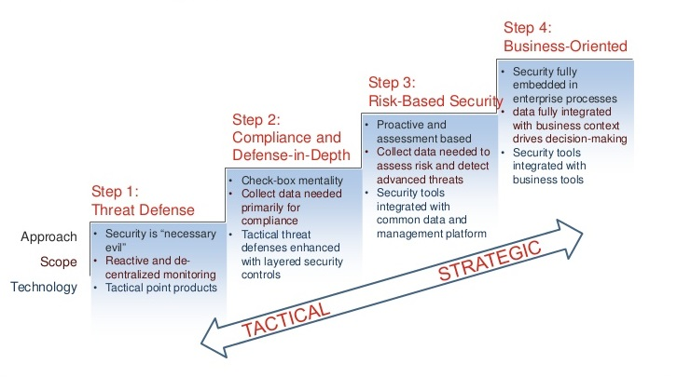
Security - Journey

Slide 9
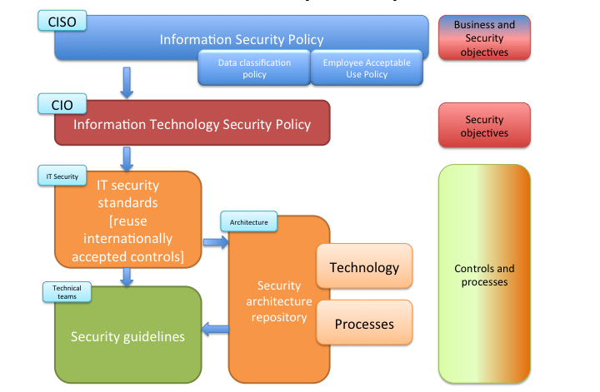
Security - Framework

Slide 10
Cyber Security
Can you account for all access to your systems?
Do you have full Visibility over your Entire environment?
How long would it take you to detect and recover from a cyber attack?
Would better Cyber security increase revenue or reduce costs?
Do you know exactly how many assets you have and if they are fully protected?
Notes:
At the beginning of the year we restructured to 4 business units so as to have the right focus to our customers

Slide 11
Cyber Security
ACCESS PROTECTION
Advanced Threat Protection
Sandboxing
Web & Email Gateways
Data Loss Prevention
Encryption
Data Integrity
Antivirus / Anti Malware
Employee Access & Activity Monitoring
Encryption
Asset Mgmt
Vulnerability / Patch Mgmt
Anti Ransomware
Anti Phishing / Anti Spam
Rights Mgmt
Data Privacy / Integrity
Fraud Mgmt
IT Disaster Recovery & Mgmt
Bring Your Own Device Mgmt
ASSET PROTECTION
Next Gen Firewall
Internal Firewall
Unified Threat Mgmt
Network Access Control
Identity & Access Mgmt
Anti DDOS
Wifi Protection
Internet Of Things
Database Access Mgmt / Database Firewall
Web Application Firewall
Multi Factor Authentication
Anti Web Page Hijacking
Anti Man In The Middle Attacks
Application Rating
Priviledged Identity and Access Mgmt
Intrusion Prevention / Detection System
Security Incident & Event Mgmt
Notes:
At the beginning of the year we restructured to 4 business units so as to have the right focus to our customers

Slide 12
Thank You!

